Slide 1
Books for doing RESEARCH

Slide 2
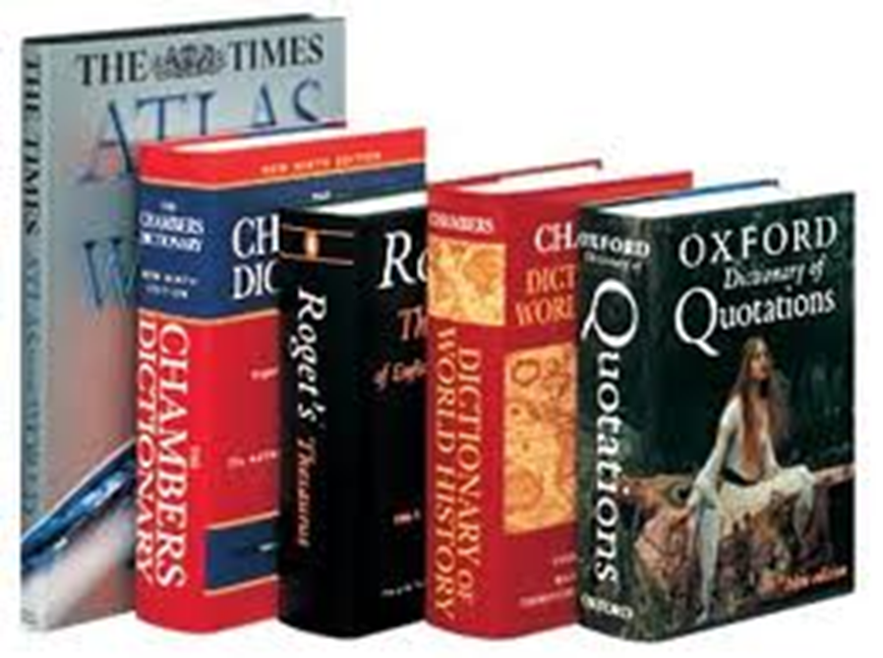
Every library has a special section that has books for doing RESEARCH

Slide 3
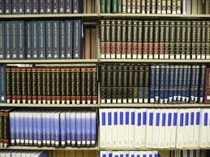
This is called the REFERENCE section

Slide 4

It is full of heavy books

Slide 5
What kinds of books?

Slide 6
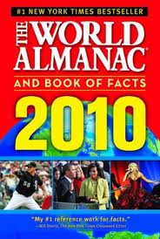
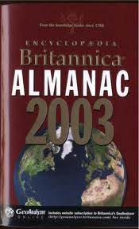
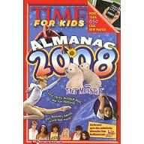
Almanac

Slide 7
ALMANAC
An annual reference book of useful and interesting facts about countries of the world, sports, entertainment, etc.

Slide 8
Almanac

Slide 9
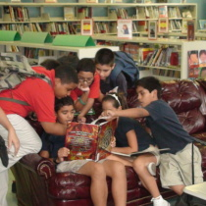
These kids are reading their favorite ALMANAC

Slide 10
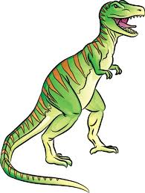
Thesaurus

Slide 11
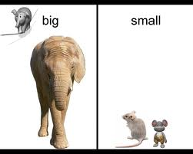
Thesaurus

Slide 12
THESAURUS
A dictionary of synonyms and antonyms, i.e.
words that have the same meaning (synonyms)
and words that are opposites (antonyms).

Slide 13
Thesaurus

Slide 14
Thesaurus

Slide 15
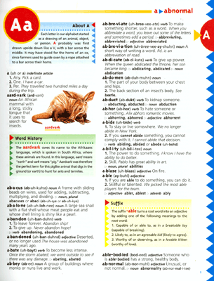
Dictionary

Slide 16
DICTIONARY
A book that tells you the meanings of words.

Slide 17
Dictionary

Slide 18

Atlas

Slide 19
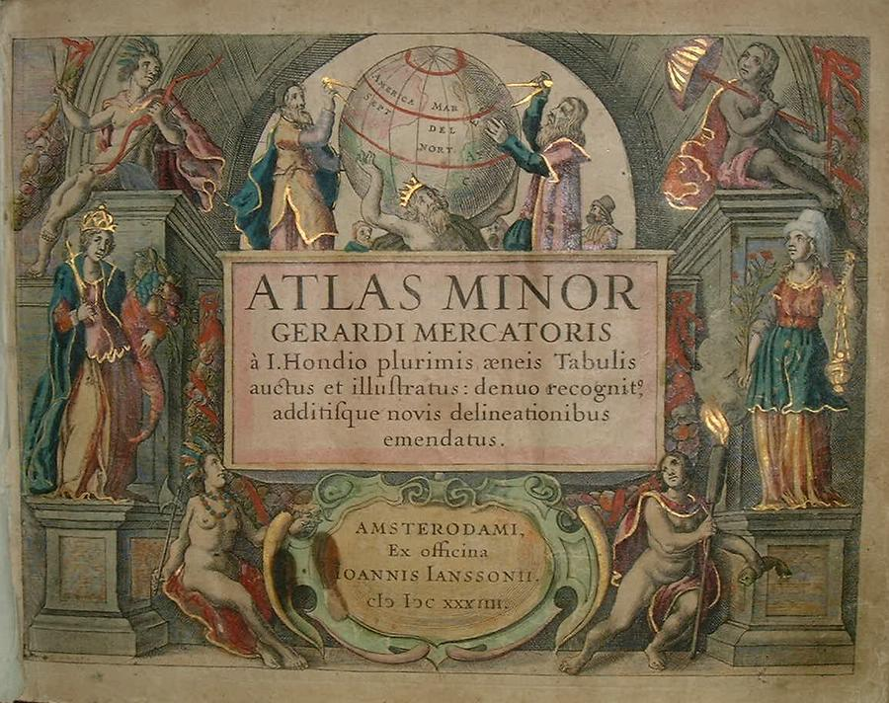
Atlas

Slide 20
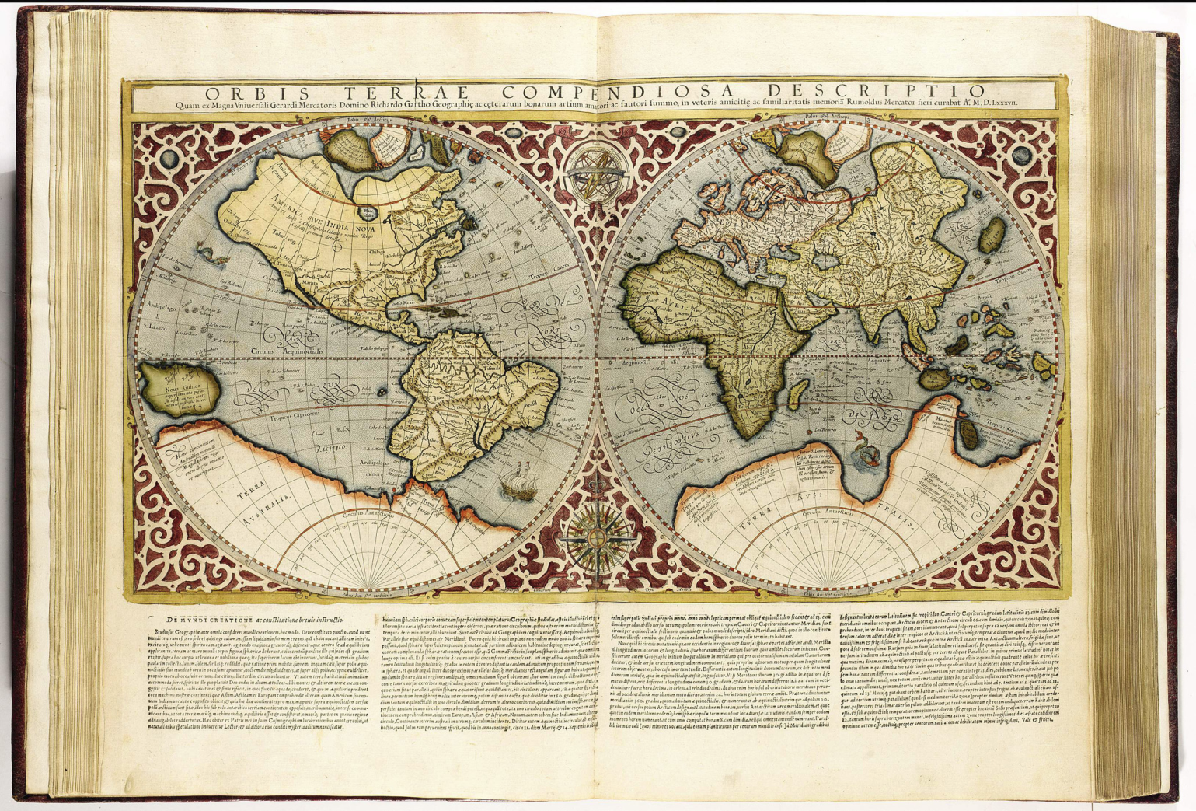
Atlas

Slide 21
ATLAS
A book of maps

Slide 22
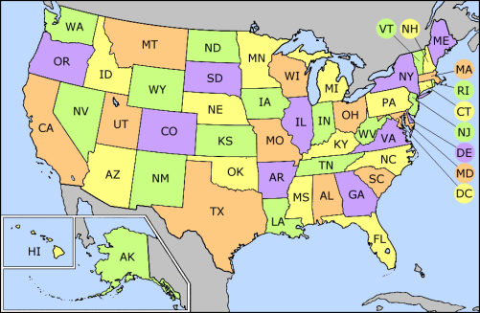
Atlas

Slide 23
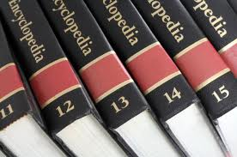
Encyclopedia

Slide 24

Encyclopedia

Slide 25
ENCYCOPEDIA
A book, or a set of books, with information on many topics – usually arranged alphabetically

Slide 26
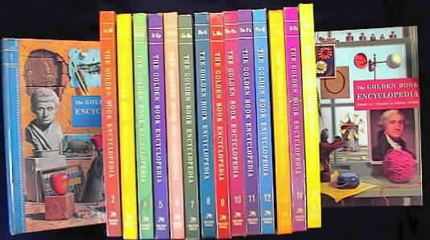
Encyclopedia

Slide 27
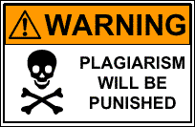
Plagiarism

Slide 28
Plagiarism

Slide 29
PLAGIARISM
Copying

Slide 30

Plagiarism
CAREFUL!
YOUR TEACHERS
ARE SMARTER
THAN YOU THINK!!!

Slide 31

Bibliography

Slide 32
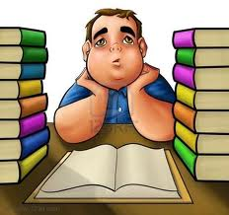
Bibliography

Slide 33
BIBLIOGRAPHY
A list of all the books that you read to make your report

Slide 34
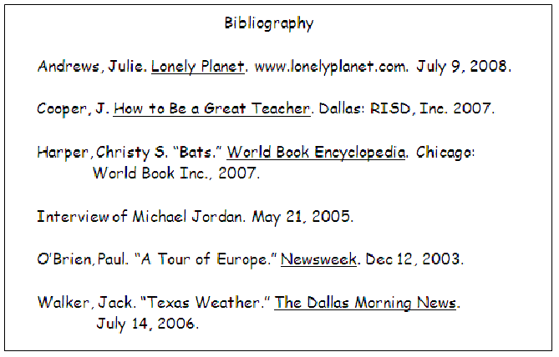
Bibliography

Slide 35


Slide 36

What are these books?

Slide 37


Slide 38
Almanac

Slide 39
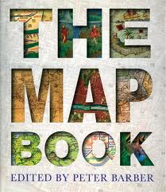

Slide 40


Slide 41
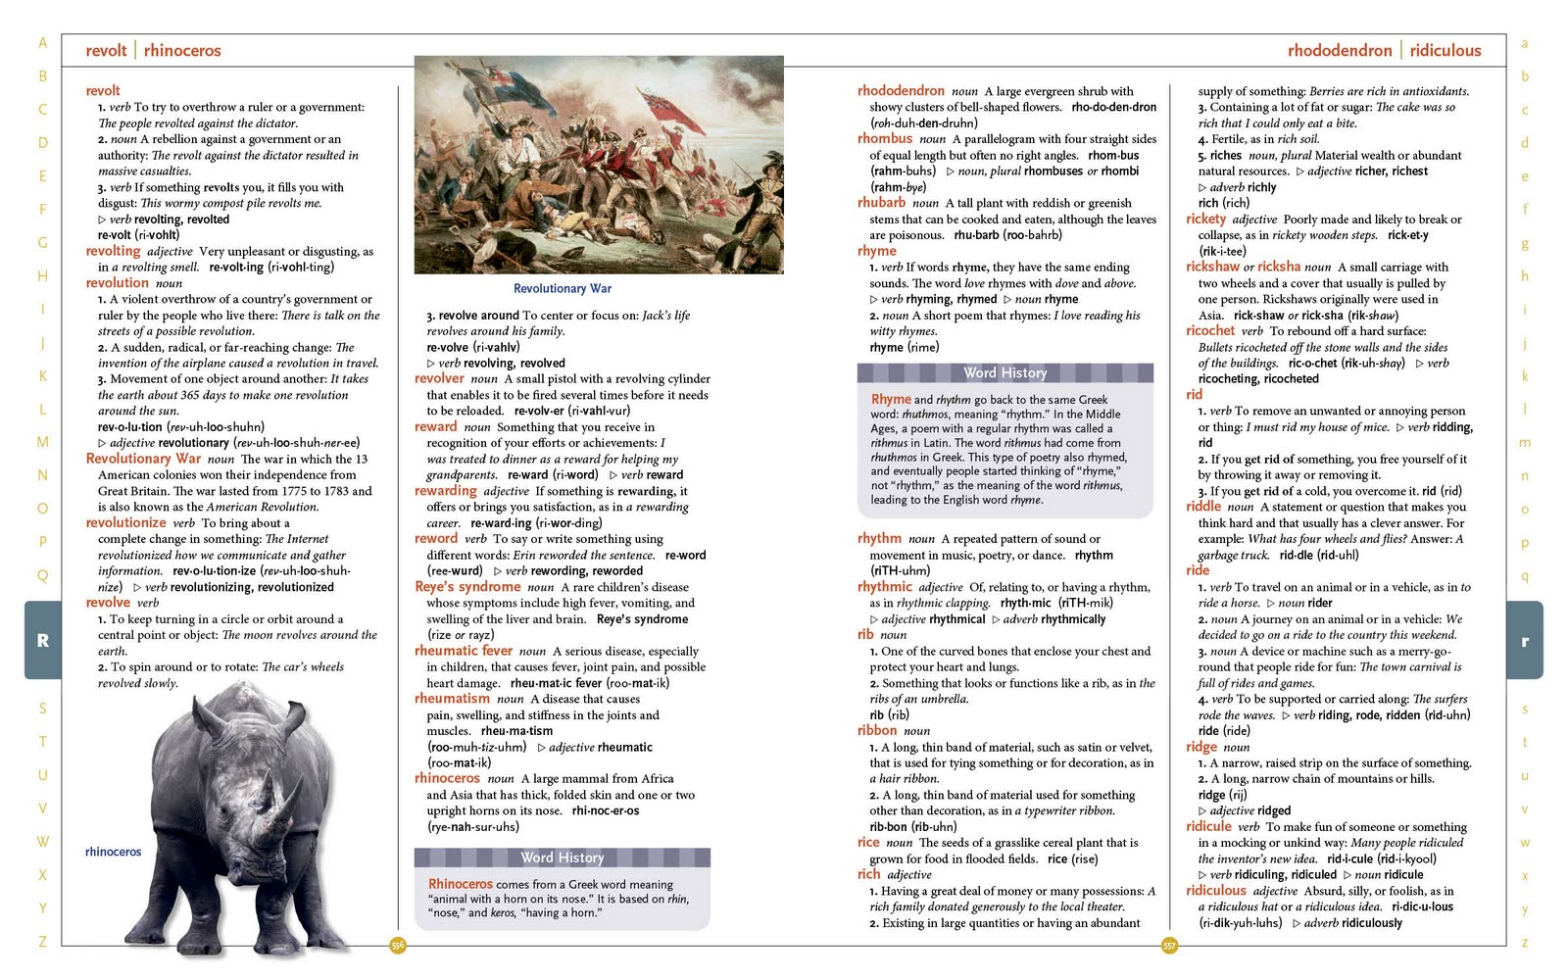

Slide 42


Slide 43
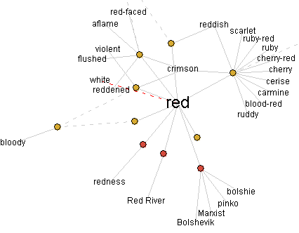

Slide 44


Slide 45
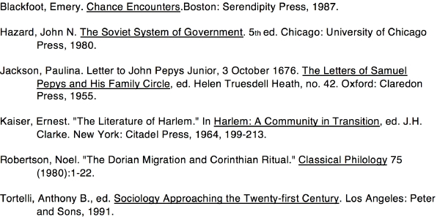

Slide 46


Slide 47
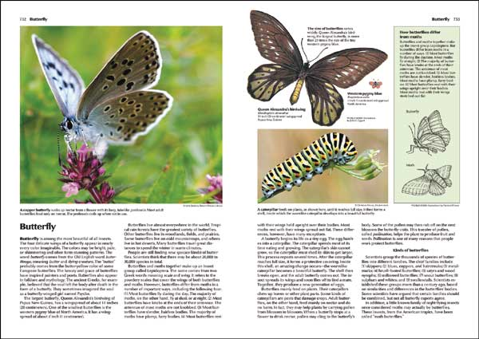

Slide 48


Slide 49
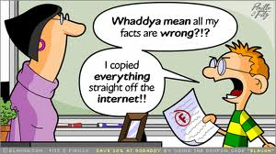

Slide 50


Slide 51


